Slide 1
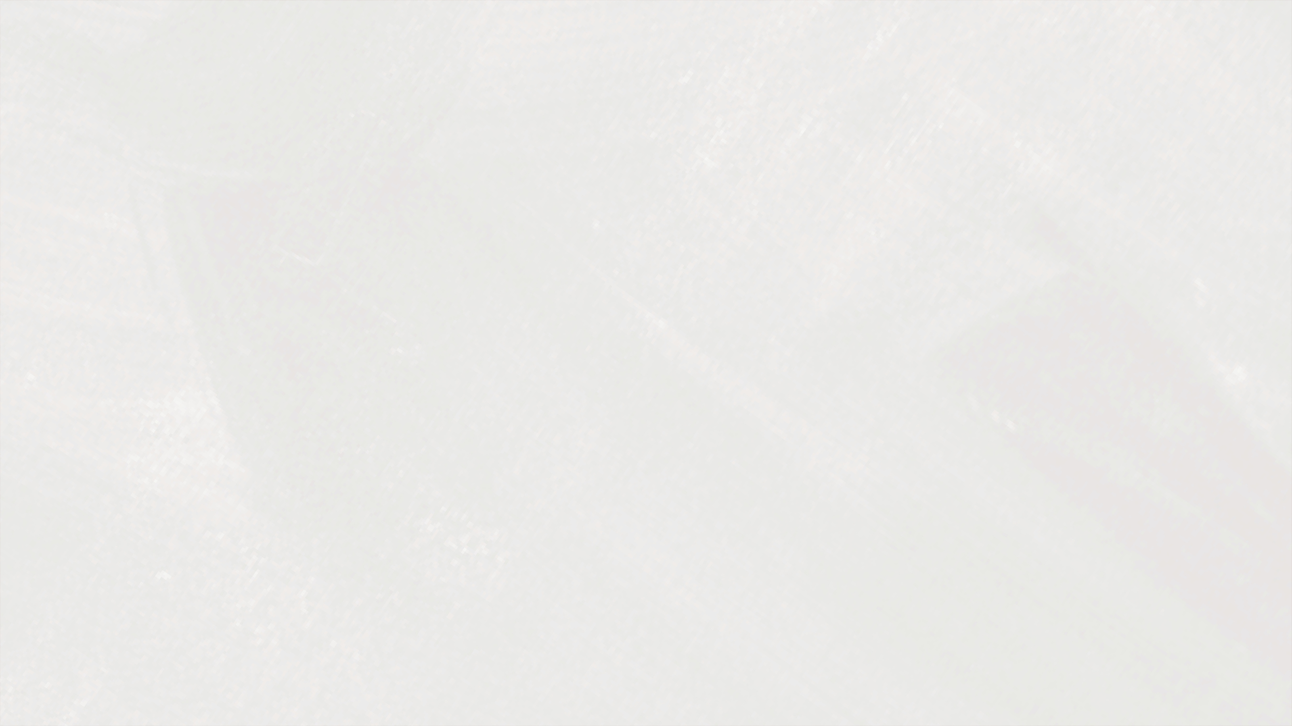
Pinhole sunglasses
IYPT - PROBLEM 1
Parikshit Narang

Slide 2
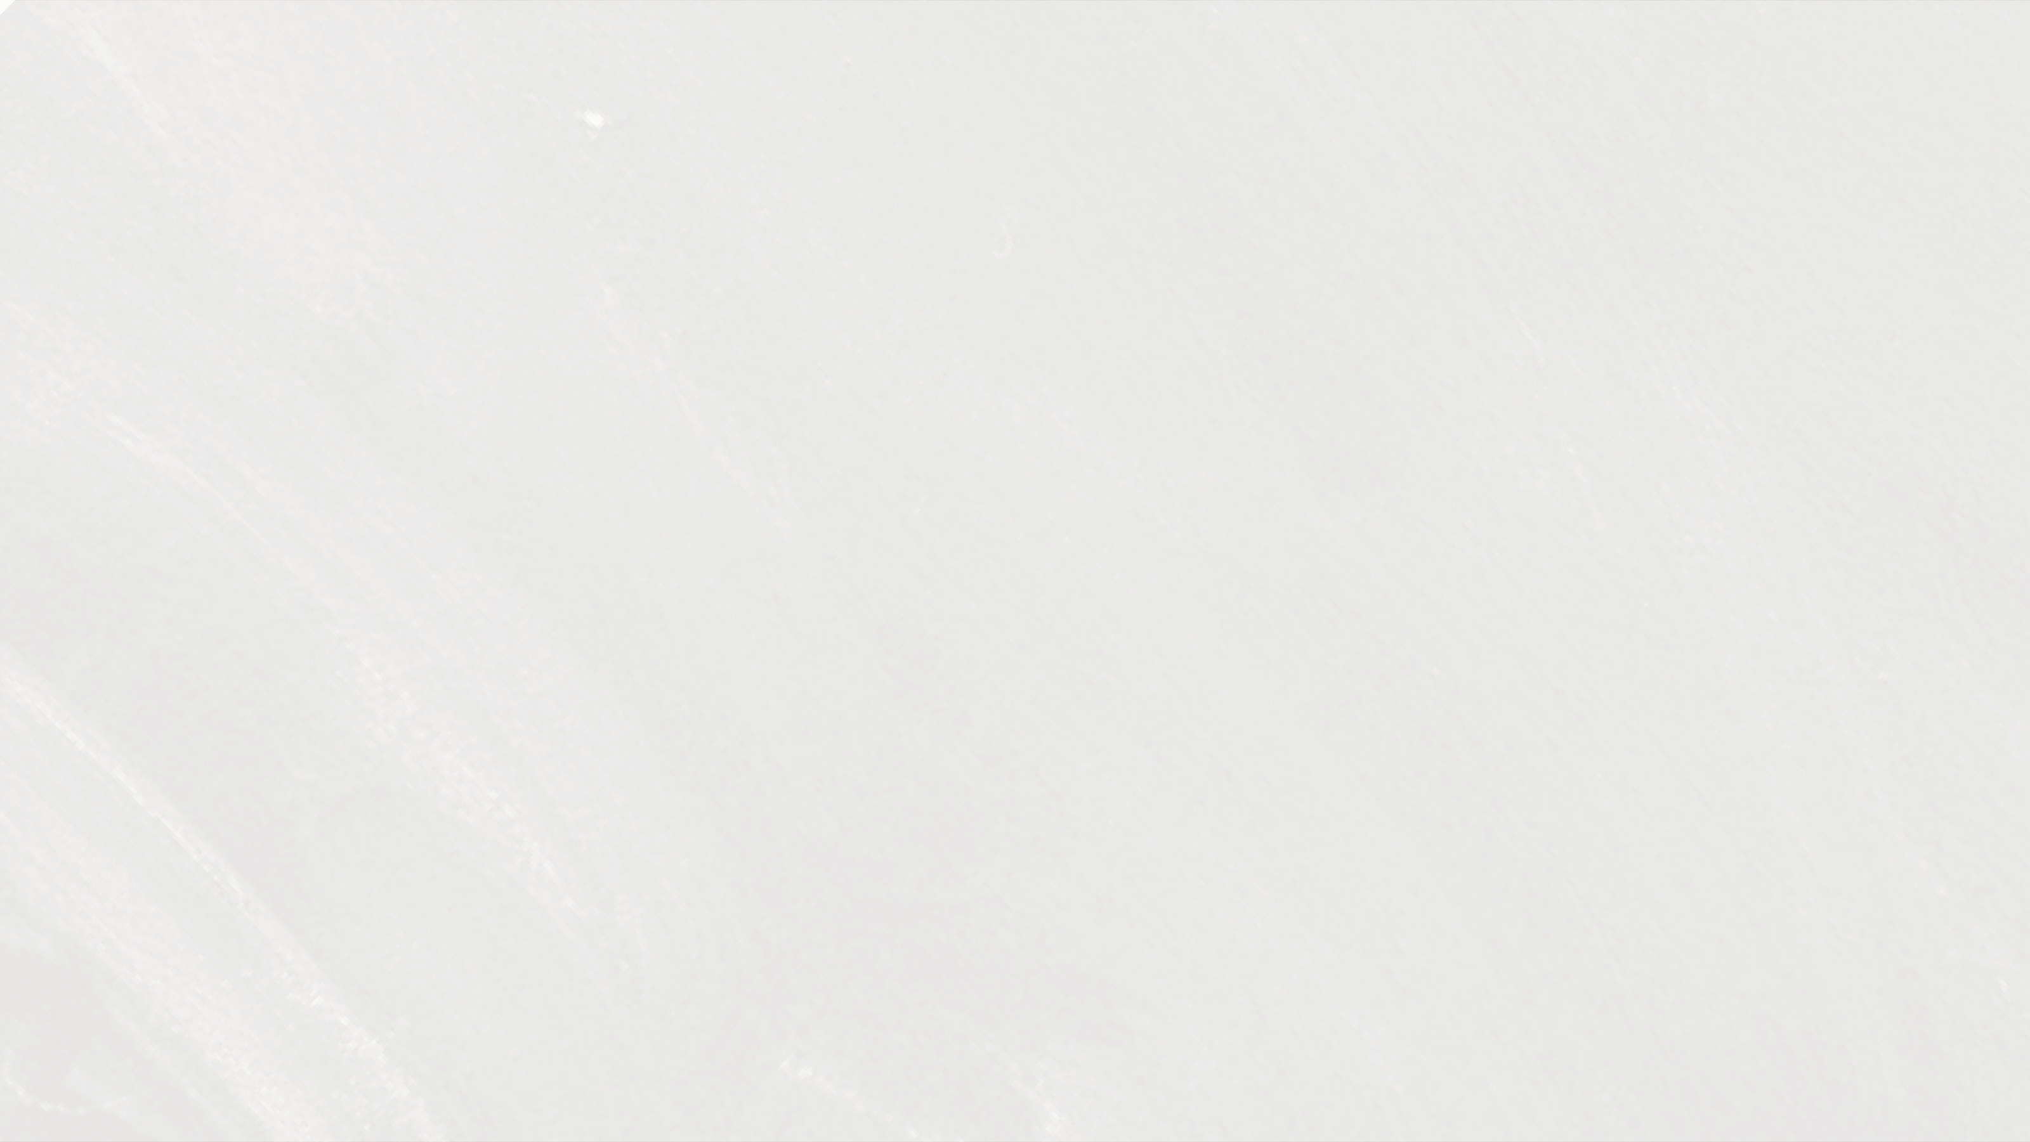
Table of Contents
1
2
3
Problem
Basic Physics
Solving Approach
6
7
8
Theory model
Model Results
Experiment
9
10
11
Experimental Results
Comparison
Conclusion

Slide 3
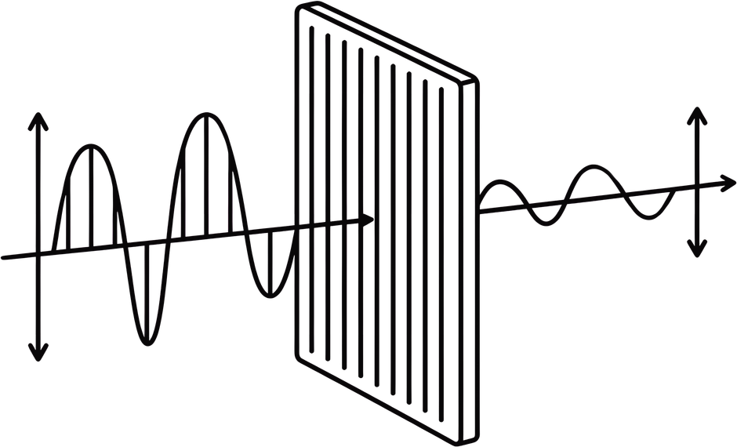
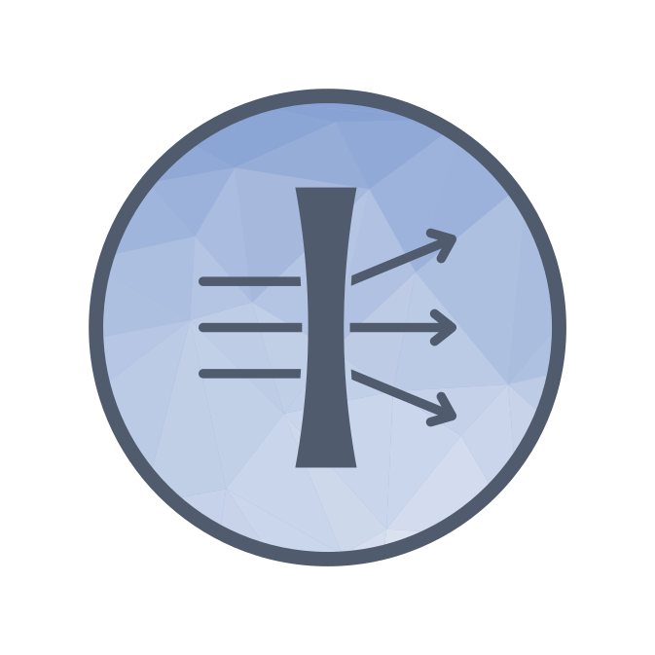
Problem Statement
Investigate the optimal arrangement of pinholes in an opaque film to produce sunglasses that reduce light intensity and help correct short-sightedness.
3

Slide 4
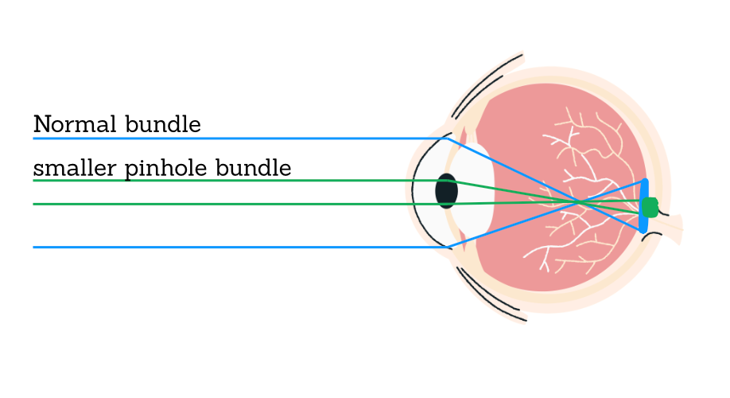
A myopic (short-sighted) eye focuses distant light in front of the retina, not on it – the retinal image is a blur disc, not a point.
Standard correction: a diverging lens (glasses/contacts) restores focus.
Pinhole optics offer a lens-free alternative: a
small aperture placed in front of the eye
restricts the cone of rays reaching the retina,
shrinking the blur disc geometrically – without
refracting light at all.
This is the physical basis of pinhole glasses,
marketed as a correction-free vision aid
So reducing the size of the pinhole aperture reduces the blur due to the optical geometry
This is called Stenotopic effect
6

Slide 5
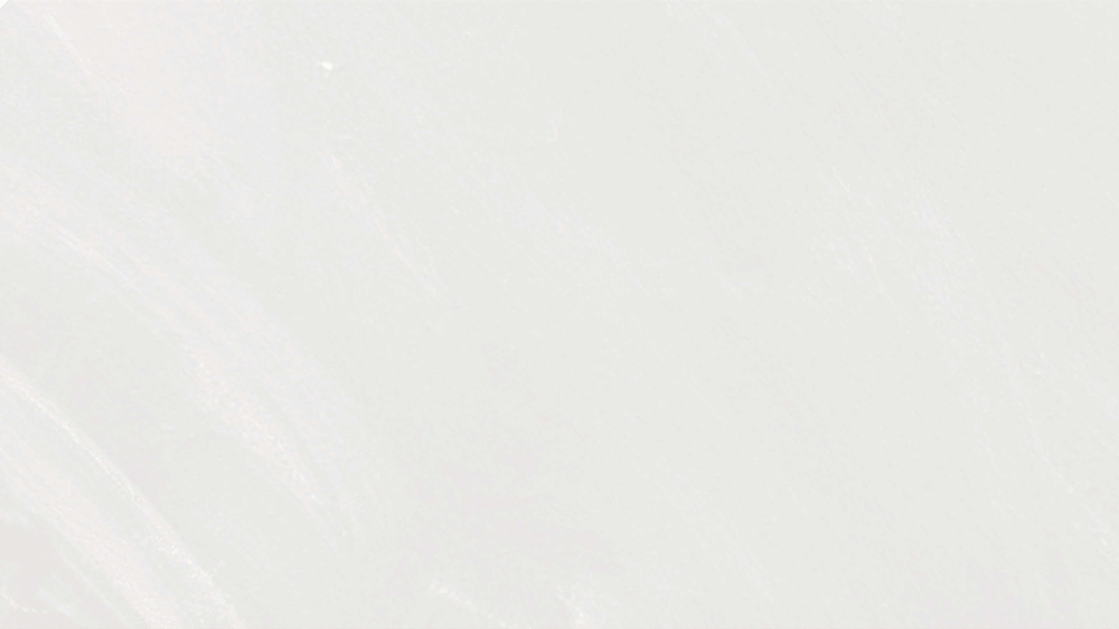
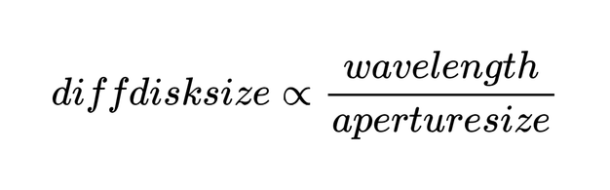
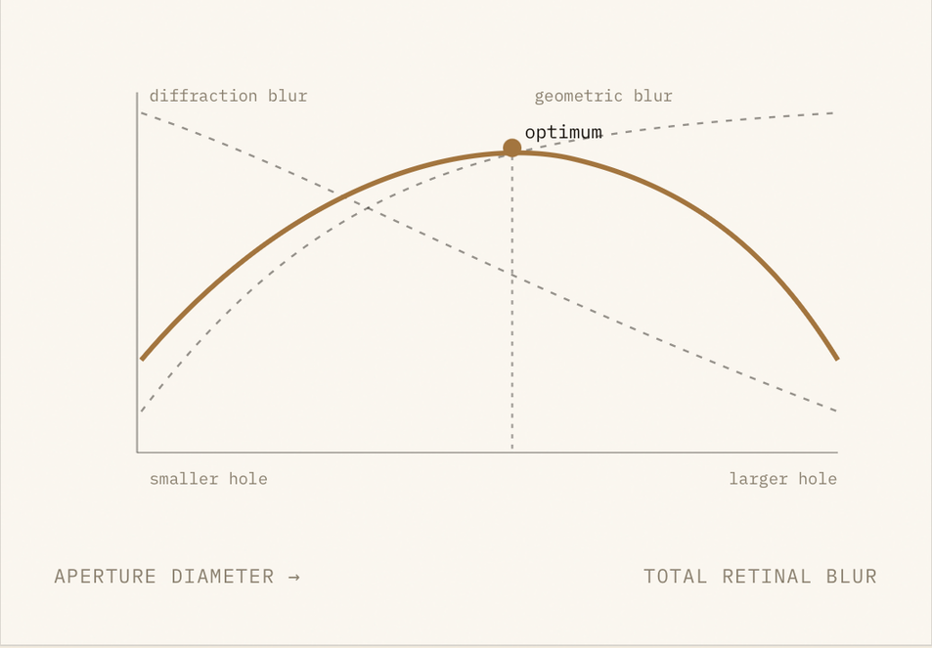
Shrinking the aperture reduces geometric blur linearly with aperture diameter – naively,
smaller is always better.
But a small aperture
increases diffraction blur
Contradiction
These two effects trade off oppositely with aperture size ⇒ there is an optimum
aperture for every myopic power M, not a ”smaller is always better” answer.
This project’s core question: find that optimum, validate it against real photographic
measurement, and check it against independent clinical literature.
4

Slide 6
Solving Approach
Phase 1
Phase 3
Develop theoretical model to obtain the optimum aperture size for each myopia power
Develop Theoretical model to obtain most suitable array of appropriate sized aperture for each myopia power
Experimentally Verify the model’s optimum aperture to myopia power findings
Fabricate and experimentally Verify the optimal array designs
Phase 2
Phase 4
10

Slide 7
Theoretical optimisation of singular aperture
Phase 4

Slide 8
Theoretical Model For single aperture optimisation
Aim: determining optimal aperture size and dimensions for each power of myopia
3

Slide 9
Optimal Aperture shape
Circular apertures are optimal:
at fixed area the circle minimizes the circumscribed
diameter, which gives it the highest acuity and the lowest ghost rate among the
genuinely non-circular shapes in all tested conditions
(tied only with the degenerate ellipse),
while elliptical apertures are quantitatively ruled out (up to −44% acuity and a
ninefold ghost-rate increase) and annular apertures pay a sidelobe penalty of 31.5–62.5% of
the transmitted energy. [Jizhong Shen et al. , Researchgate , 11 Aug 2026]
This is also in line with the natural intuition for developing optical apertures
3

Slide 10
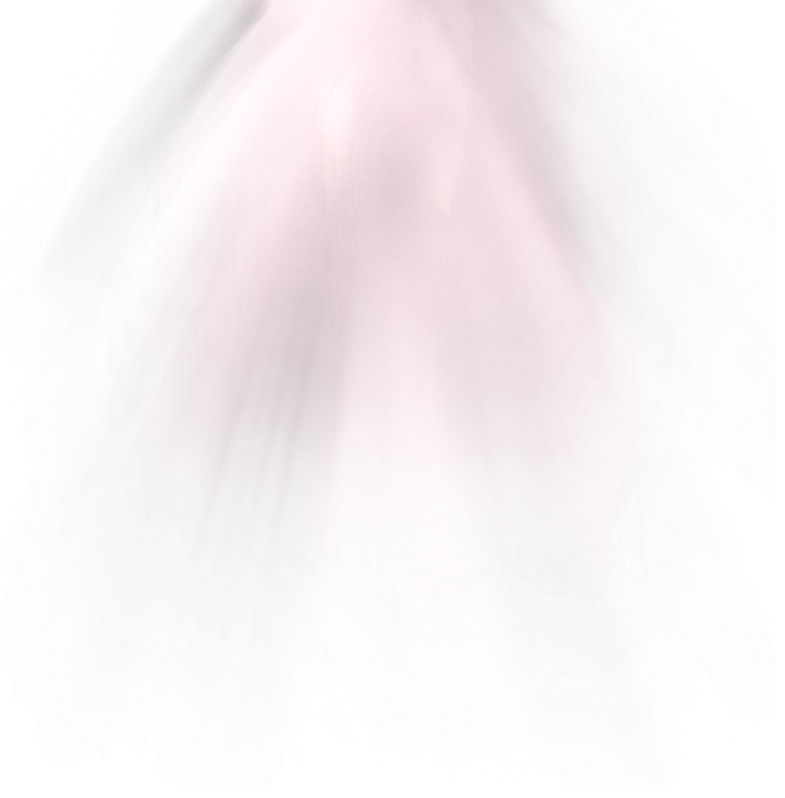
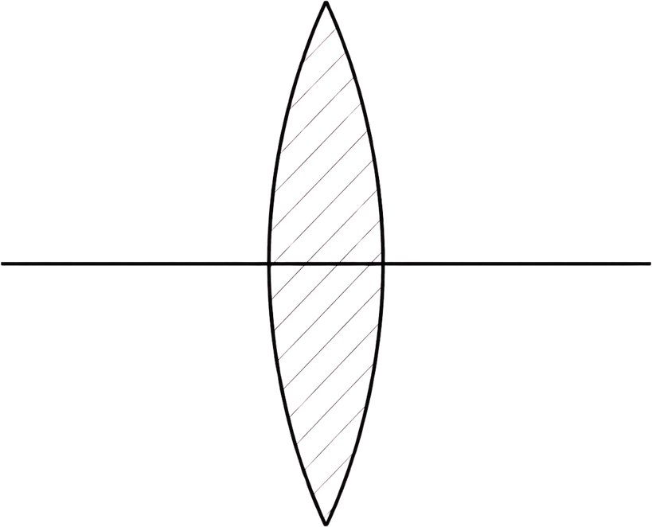
Reduced eye model : Mathematical model
Pinhole Array
60D eye lens
n= 1.336 (vitreous refractive index)
Retinal screen
Pinhole to cornea distance =12mm
d>= 22.267 mm
Axial length of eye
vitreous humor
Light source
Pupil size computed by 2012 watson yellot model
3

Slide 11
Reduced eye model : Mathematical model
Pinhole Array
60D eye lens
n= 1.336 (vitreous refractive index)
Retinal screen
Pinhole to cornea distance =12mm
d>= 22.267 mm
Axial length of eye
vitreous humor
Light source
Pupil size computed by 2012 watson yellot model
3

Slide 12
Optical Pipeline
Light source
Vitreous humor
Retina
Pinhole Array
Eye lens
Air Gap
Pupil
Cornea
Aqueous humor
4

Slide 13
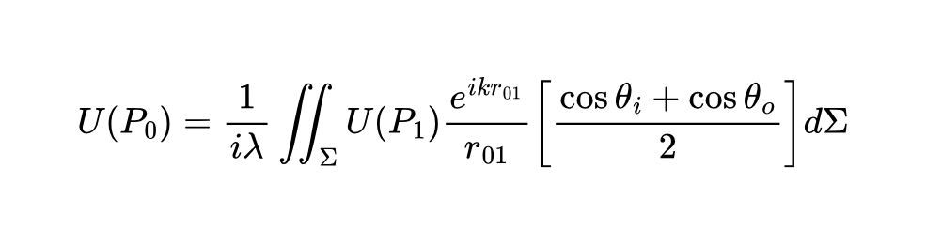
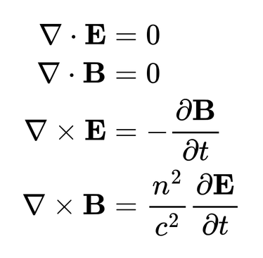
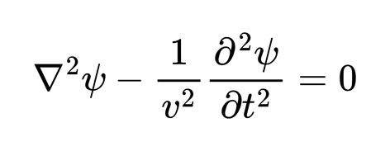
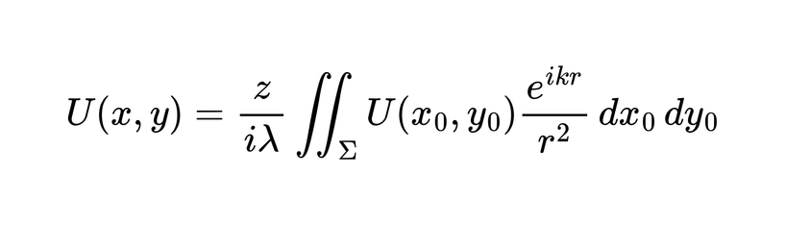
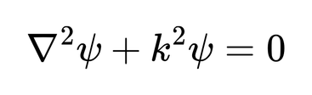
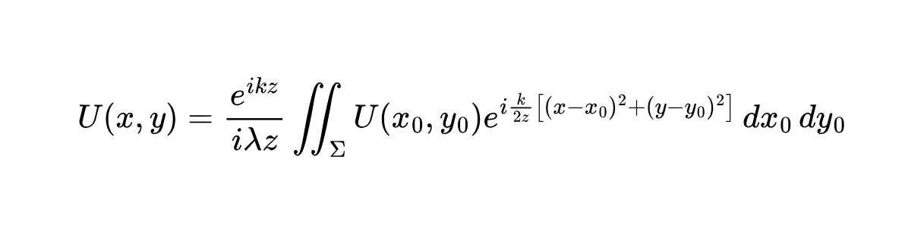
Wave optics simulation
The wave optics simulation is governed by some basic equations
Scalar wave equation
Kirchofff diffraction integral
Maxwells eqautions
Helmoltz equation
Rayleigh sommerfield diffraction
6
Fresnel DIff integral.

Slide 14
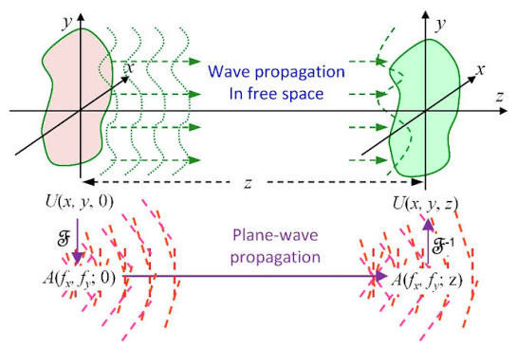
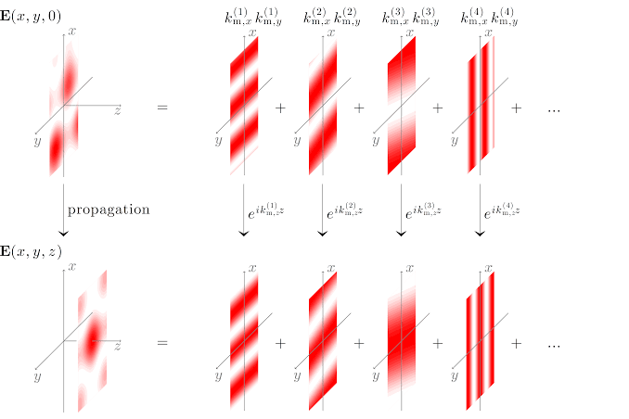
Light Propagation Model - ASM
Full Wave-Optics Simulation (ASM)
This Model instead of approximating propagates the complete complex spatial field through the reduced eye system and determines the final distrubition of light energy onto the retina
Propagates a coherent field from the aperture,
through a 12mm air gap, through the eye lens to the Retina
Skips need for combining Geometric and Diffraction blurs and simply gives us the Final energy distribution
11

Slide 15
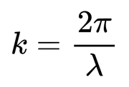
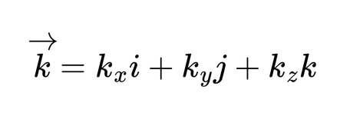
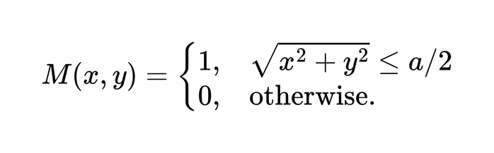
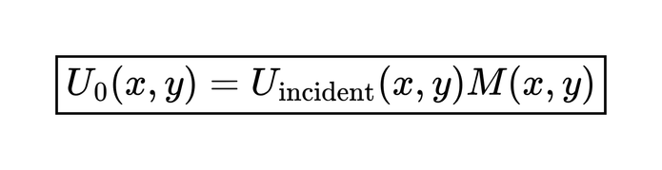
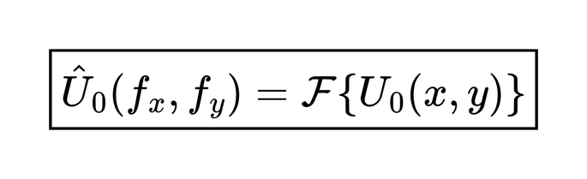

ASM Mathematics
The FFT of the Spatial Field gives us the diff Plane waves and their amplitude , Phase change in a particle angular direction (kx,ky) at a point (x,y)
Start of with a field
U(x,y,0) at z =0 and a particular point x,y
This z=0 is at the beginning of the Pinhole ,
now the circular pinhole applies a Mask
The angular plane waves are then propagated in the z direction
Now the
undergoes a Fourier Transform (FFT) which
qualitatively decomposes the Complex spatial field into Angular spectra
11

Slide 16

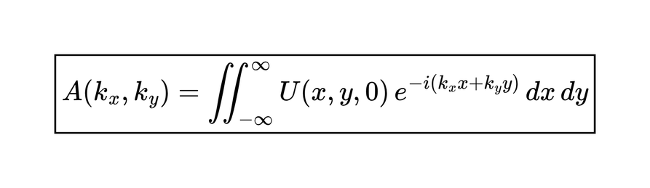

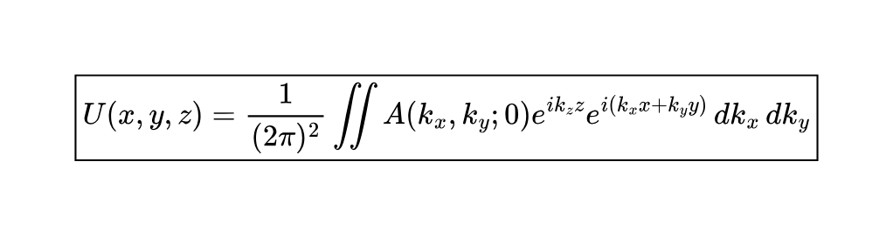
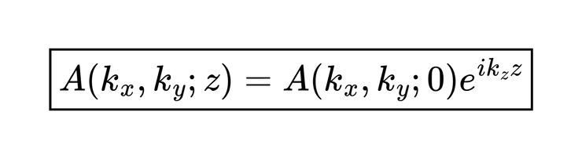
ASM Mathematics
This is the propagation function / phase the plane wave gains over travelling distance z
The FFT (fast fourier transform ) of field gives us a grid or arrray of results consisiting of the various interacting possible plane waves and their phase change in a particular direction .
Now after travelling through the gap between Pinhole and cornea the energy field over the cornea is determined by recomposing this angular spectra by IFFT
(inverse fourier transform )
A(kx,ky) is the angular spectrum consiting of this array
Each plane wave has its own which determines the phase change when it propagates in z direction

Slide 17
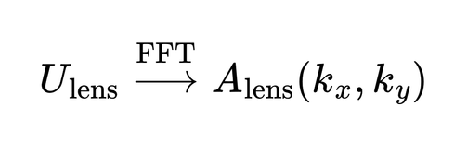
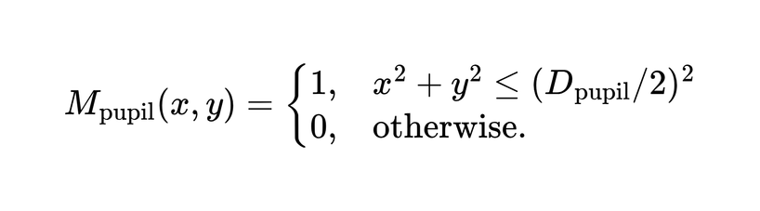
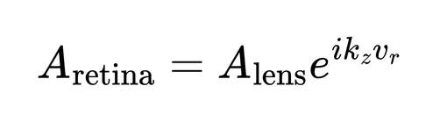
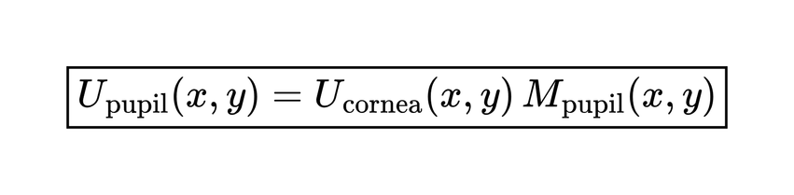
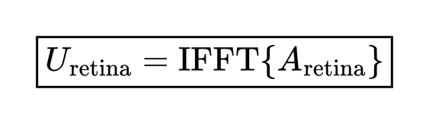
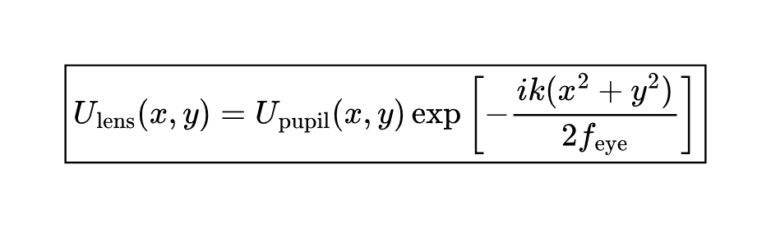

ASM Mathematics
After entering through cornea , the Pupil Mask clips the spatial wave
Now spectral Field is recomposed at the Retina by Inverse FFT
after entering through pupil the light field undergoes Focusing action by the eye lens
Now this focused field is decomposed by FFT and propagated through Vitreous humor

Slide 18
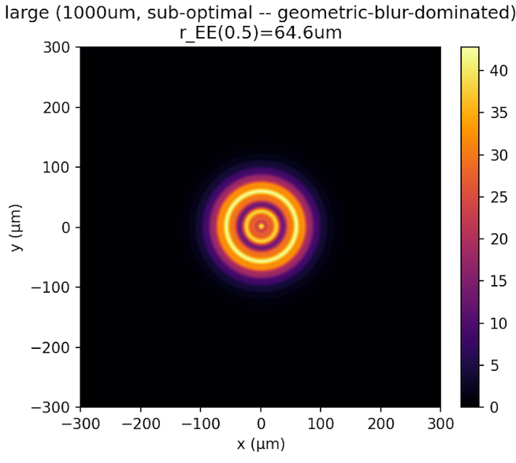
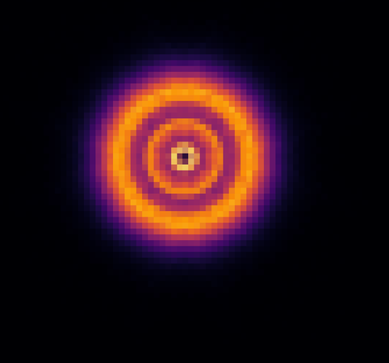
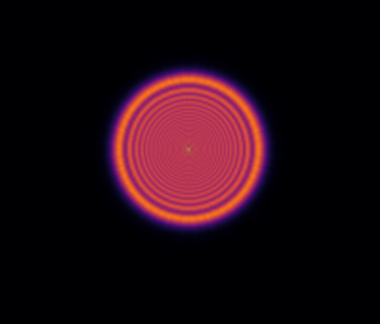
Light Propagation Model - ASM
Full Wave-Optics Simulation (ASM)
The Final wave optics simulation of ASM directly produces the light energy distribution on the retina removing scope of error
This distribution is then used to calculate various metrics like
PSF , OTF , MTF cutoffs , EE(encircled energy) , Blur radiusm , FWHM and determine most appropriate aperture for each myopia power
Diffraction pattern calculated by ASM
11

Slide 19
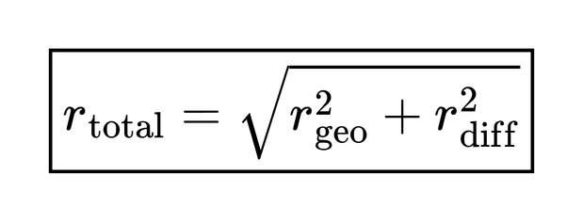
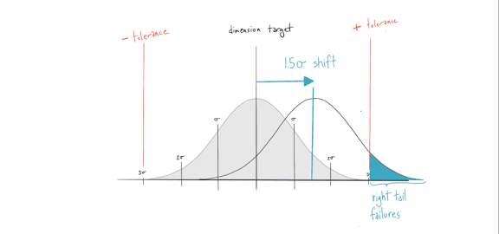
Light Propagation Model - RSS
RSS (Root sum square) model
This assumed that there were two independent sources of blur:
  Geometrical defocus blur
  Diffraction blur
It calculated each separately and then combined their radii using
This same approach was used by the paper [Jizhong Shen et. al. 11 aug 2026]

Slide 20
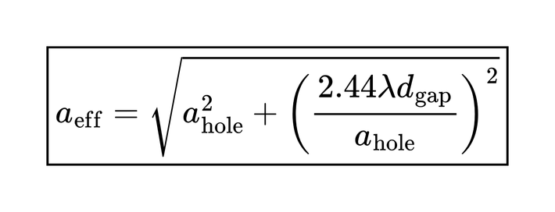


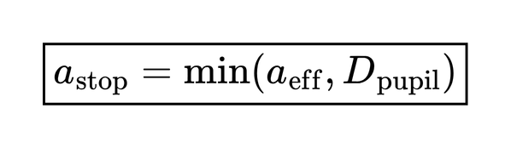
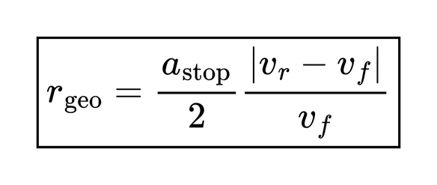
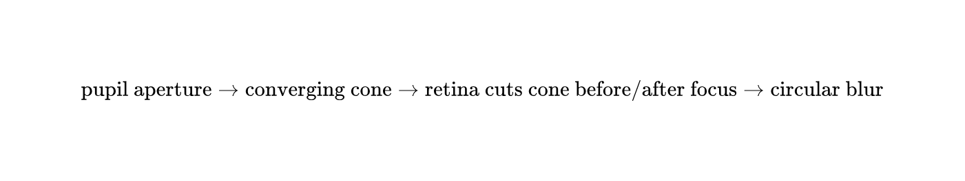
Light Propagation Model - RSS
First Light passes through the pinhole and produces a bright pattern on cornea surface whose size is approximated by
Now the the geometric blur due to the bundle of rays
If the lens would focus at but the retina is actually at the cone of rays has not yet converged to the correct point.
The resulting geometric blur radius was
Now imposing the limit by the pupil size
Now imposing the limit by the pupil size

Slide 21
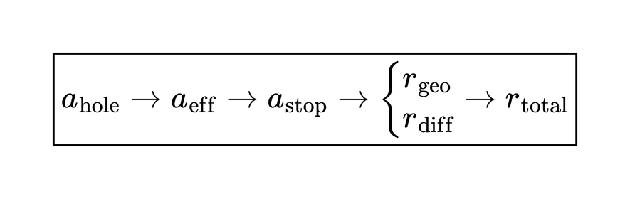
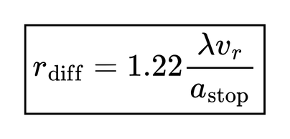

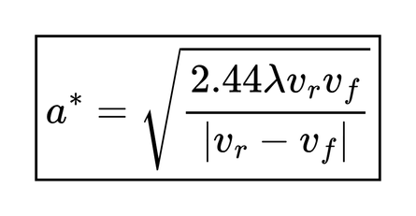
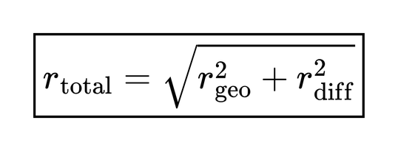
Light Propagation Model - RSS
model then independently calculated a diffraction radius using the Fraunhofer/Airy first-null expression:
Now differentiating the the final prediction
This gives us optimal aperture for each myopic power
This is essentially the Airy first-null radius.
Now combining both blur radius
This is the RSS propagation model's final blur prediction
This is attractive because it gives us a single straightforward answer

Slide 22
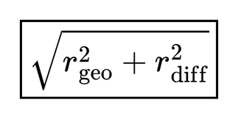
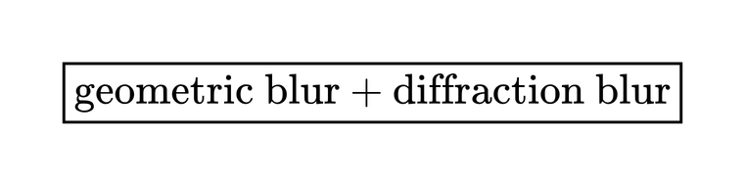
Drawbacks of RSS model over ASM
However this simplified calculation model has many crucial drawbacks
Problem 1 — You cannot generally add blur radii in quadrature
The fundamental error is:
does not represent the true physical combination of the two optical effects.
Problem 2 — Diffraction is not an independent "blur radius"
This is an even deeper way to understand it.
The RSS model thinks:
as if they were two independent random errors.
But in wave optics, the field is propagated as a complex amplitude.

Slide 23
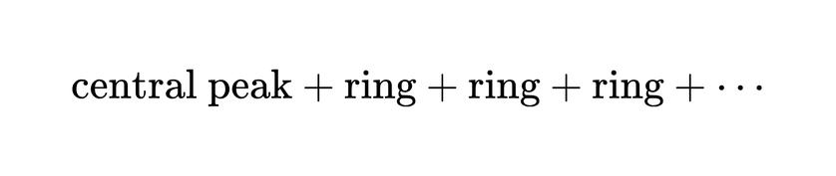
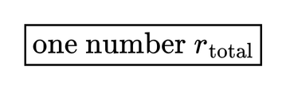
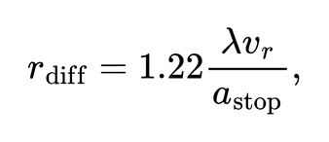



Drawbacks of RSS model over ASM
Problem 3 — RSS uses Fraunhofer diffraction where the system is Fresnel
The RSS model uses
which comes from the Airy/Fraunhofer picture.
But The Problem’s Fresnel number is
and many of the configurations lie in the transition-to-strong-Fresnel regime
Problem 4- It reduces a complicated PSF to one radius
Suppose the retinal intensity looks roughly like:
The RSS model says:
But the actual ASM gives:
from which you can calculate:
and subsequently MTF/OTF etc.
So the ASM retains the entire spatial structure rather than collapsing it prematurely.

Slide 24


Comparison to shen paper
Shen et al. use an RSS approximation,
. Importantly, the authors themselves call this an ‘engineering approximation’ and state that a faithful treatment of a defocused pinhole requires the full defocused OTF.
Our approach goes one step closer to the underlying wave physics: instead of assigning separate geometric and diffraction blur diameters and combining them, we propagate the complex field through the actual optical system using the Angular Spectrum Method. The retinal intensity distribution is then obtained directly as , allowing quantities such as encircled energy to be calculated from the actual PSF.
“

Slide 25
Important Fundamental flaw pointed out and corrected
There's a standard result in Fourier optics: a lens followed by a single FFT gives the field at that lens's own back focal plane. It's correct, and it's the technique most people default to. The hidden assumption is that your detector sits at that focal plane.
For a myopic eye it doesn't — that mismatch is the definition of myopia. Apply the standard technique anyway and you get a perfectly sharp, perfectly plausible Airy pattern, at the one place in the system with zero defocus. Nothing about that output signals it's wrong.
We caught it because our validation checked the actual physical distance being propagated, not just whether the result looked like a reasonable point-spread function. The fix is a second Angular Spectrum propagation to the true axial length, not another FFT."
“

Slide 26

Cross Validation
We validated the propagation engine against two independent closed-form solutions —
the Fraunhofer diffraction limit at zero gap, matching to 2%, and
the analytic on-axis Fresnel-zone oscillation at arbitrary distance, matching at correlation 0.997 — plus a separate grid-convergence check confirming the numerics themselves are stable to 0.07%.
“

Slide 27

Cross Validation -1
“

Slide 28

Cross Validation -2
“

Slide 29

What we calculate from the ASM simulation
We calculate multiple metrics of the light intensity distribution on the retinal surface

Slide 30


Aperture to blur radius data(rEE50)

Slide 31


Aperture to blur radius data(rEE70)

Slide 32


Aperture to blur radius data(rEE80)

Slide 33


Aperture to blur radius data(rEE90)

Slide 34


Actuity Model
In order to obtain most optimum aperture simple blur minimistaion isnt that effective because the retina doesnt respond linearly to blur distribution
And we combine these metrics to produce an mathematical /physiological model to predict the actuity that the eye can reach
Hence we measured multiple Optical quality and Actuity metrics like

Slide 35





Actuity Model : LogMAR
Model predicts the optical quality that one can reach on the LogMAR table
And also a penalty system Delta_bright , if it is too dark it creates a penalty
Source:”Van Nes, F.L. & Bouman, M.A. (1967). "Spatial Modulation Transfer in the Human Eye." Journal of the Optical Society of America, 57(3):401–406.”

Slide 36


What does the actuity model predict
The actuity model predicts

Slide 37

What does the actuity model predict
The actuity model predicts

Slide 38

Actuity model vs Blur minimisation

Slide 39

Actuity model vs Blur minimisation

Slide 40


Actuity model vs Blur minimisation : M0d

Slide 41


Actuity model vs Blur minimisation : M1d

Slide 42


Actuity model vs Blur minimisation : M2d

Slide 43


Actuity model vs Blur minimisation : M3d

Slide 44


Actuity model vs Blur minimisation : M4d

Slide 45


Actuity model vs Blur minimisation : M6d

Slide 46


Actuity model vs Blur minimisation : M8d

Slide 47


Best achievable blur radius

Slide 48

VSOTF Values

Slide 49

Snellen denominator

Slide 50

Retinal illuminance

Slide 51

Final conclusive results of the Reduced eye ASM simulation

Slide 52

We use the Actuity optimal as the true optimal for each myopia power
Because it is the closest to the actual nature and responsiveness of the human eye
And also aligns with the experimental data in the following section

Slide 53
Experimental Verification for optimal aperture size
Phase 2

Slide 54



Experiment 1
Simulate defocused myopic eye on a phone camera and then capture images through aperture corresponding to myopia power and evaluating image quality of scenery through BRISQUE evaluator

Slide 55

Experiment 1: BRISQUE Scenery
The lower the BRISQUE score higher is the image quality

Slide 56


Experiment 1: BRISQUE Scenery

Slide 57


Experiment 1: BRISQUE Scenery

Slide 58




Experiment 1: BRISQUE Scenery
M0d
no pinhole
500um
700um
1000um

Slide 59




Experiment 1: BRISQUE Scenery
M4d
no pinhole
500um
700um
1000um

Slide 60



Experiment 2
Artificial eye model and the light distribution due to a pinhole and a parrallel light ray source on a variable frosted screen at demarcated deviations
20 D eye lens
Pinhole
Frosted Screen
Led
Camera
FIxed distance
Collimator lens
Variable Image distance using rack and pinon wheel
Distance = 12mm

Slide 61

Experiment 2

Slide 62


We start by building a collimater led to produce an infinite distance object source
A 20D Convex lens simulates the eye lens
A movable rack and pinon system is used to move a variable distance screen
Experimental setup
The frosted screen is displaced by 5mm 10mm 15mm and 20 mm to simulate axial length in myopic eyes
The image formed on the screen is photographed by a camera and is analysed by a python script

Slide 63



Experimental setup

Slide 64


Experimental Result
The analysis of the image data reveals a linear variation between the measured radius and linear deviation from the screen
This is identical to the theoretical predictions by our ASM propagation model and also our systemic calculations for the geometric blur produced due the pinhole
Addition of pinhole of any kind reduces slope of increase of blur radius thereby experimentally verifying the fundamental
Stenotopic effect

Slide 65


400um aperture -- displacement sweep
0mm
5mm
10mm
15mm
20mm
Growth 0->20mm: 31.8% | monotonic
|
slope=0.718 px/mm
56 54 52 50
Measured radius
Linear fit (0.72 px/mm)
Equivalent radius (px)
48 46 44 42
0.0
2.5
5.0
7.5
10.0
12.5
15.0
17.5
20.0
Screen displacement (mm)

Slide 66


500um aperture -- displacement sweep
0mm
5mm
10mm
15mm
20mm
Growth 0->20mm: 30.8% | monotonic
|
slope=0.658 px/mm
56 54 52 50
Measured radius
Linear fit (0.66 px/mm)
Equivalent radius (px)
48 46 44 42
0.0
2.5
5.0
7.5
10.0
12.5
15.0
17.5
20.0
Screen displacement (mm)

Slide 67


600um aperture -- displacement sweep
0mm
5mm
10mm
15mm
20mm
Growth 0->20mm: 25.5% | monotonic
|
slope=0.601 px/mm
56 54 52
Measured radius
Linear fit (0.60 px/mm)
50 48 46 44
Equivalent radius (px)
0.0
2.5
5.0
7.5
10.0
12.5
15.0
17.5
20.0
Screen displacement (mm)

Slide 68


1000um aperture -- displacement sweep
0mm
5mm
10mm
15mm
20mm
Growth 0->20mm: 39.5% | monotonic
|
slope=0.882 px/mm
62.5 60.0 57.5 55.0
Measured radius
Linear fit (0.88 px/mm)
Equivalent radius (px)
52.5 50.0 47.5 45.0
0.0
2.5
5.0
7.5
10.0
12.5
15.0
17.5
20.0
Screen displacement (mm)

Slide 69


1400um aperture -- displacement sweep
0mm
5mm
10mm
15mm
20mm
Growth 0->20mm: 23.8% | monotonic
|
slope=0.676 px/mm
72 70 68 66
Measured radius
Linear fit (0.68 px/mm)
Equivalent radius (px)
64 62 60 58
0.0
2.5
5.0
7.5
10.0
12.5
15.0
17.5
20.0
Screen displacement (mm)

Slide 70


No-pinhole control -- displacement sweep
0mm
5mm
10mm
15mm
20mm
Growth 0->20mm: 117.1% | monotonic | slope=10.707 px/mm Control series -- NOT part of the aperture comparison
Measured radius
Linear fit (10.71 px/mm)
350
300
Equivalent radius (px)
250
200
0.0
2.5
5.0
7.5
10.0
12.5
15.0
17.5
20.0
Screen displacement (mm)

Slide 71


ExP3 Frosted Screen--Cross-Aperture Summary
All apertures overlaid
70 65 60
400um 500um
600um 800um
1000um 1400um
Equivalent radius (px)
55 50 45
0.0
2.5
5.0
7.5
10.0
12.5
15.0
17.5
20.0
Screen displacement (mm)
No-pinhole control vs aperture range (control slope=10.71 px/mm)
400
No-pinhole control
400um aperture (reference) 1400um aperture (reference)
300
Equivalent radius (px)
200
100
0.0
2.5
5.0
7.5
10.0
12.5
15.0
17.5
20.0
Screen displacement (mm)

Slide 72

Image data

Slide 73

Curve comparison

Slide 74



Experiment 3
LED array for illumination
We simulate myopic defcous through a camera and capture an illuminated eye chart through multiple pinholes and then analyse images through brisque evaluator
Brightness of Eye chart was 10,000 cd/m² simulating standard outdoor operation of sunglasses
Myopic defocused camera
Pinhole
Eye chart at distance of 2 m
BRISQUE Evaluator
Standard logMAR chart
Standard logMAR chart used

Slide 75
Standard logMAR chart

Slide 76

LogMAR capture result
BRISQUE OpenCV analysis

Slide 77

LogMAR capture result
BRISQUE OpenCV analysis

Slide 78

LogMAR capture result
BRISQUE OpenCV analysis

Slide 79

LogMAR capture result
BRISQUE OpenCV analysis

Slide 80


Experiment 4
CLINICAL TRIAL
We took 7 non myopic individuals with 20/20 and induced myopia with the help of convex lenses of specified powers and then analysed their visual actuity through multiple apertures

Slide 81

We checked the visual actuity reported by the individuals and compared to the predicted acutuity

Slide 82

Experiment 4: conclusion
Kim et al (2017) anchor
The deviation between ideal and observed though quite minimal grows non linearly as the aperture size increases
For higher aperture size and higher power the model acts slightly pessimistically ( predicts worse actutity than observed) while for lower aperture size it behaves optimistically
In almost all cases the deviation is quite minimal and not extreme

Slide 83
Experimental conclusion
The experimental dataset as previously highlighted points towards maximum similarity to the LogMAR Actuity model and hence we adopt it as the most suitable approach to determining optimum aperture size for each myopia power
The optimum aperture size corresponding to myopia degree being kept fixed we try to ascertain the most ideal method of arranging these apertures to maximise correction of short sightedness

Slide 84
Mathematical array model
Phase 3

Slide 85
Multiple Phenomenon occuring when more than 1 aperture is interacting with the pupil in an array
We want 4 things things simultaneously:
  Reduce myopic blur
  Reduce light intensity
  Avoid ghost images
  Avoid Blinding ( No pinhole in front of pupil)

Slide 86



How an Array is written as mathematically
Hexagonal lattice with pitch s
Mathematically the array is a representation of certain coordinates and radial values representating the array
square lattice with pitch s
For a periodic array with certain pitch = s ( predefined distance between 2 apertures) it can be represented by an equation

Slide 87





Light intensity
Light intensity has 2 main metrics which involve controlling
1.Fill Factor
Determines the percentage of light falling on the surface that passes through determining brightness / darkness of sunglasses
2.Active pinholes
Number of Pinholes actively interacting with pupil and allowing light to enter into it

Slide 88

Fill factor
Fill Factor determines the percentage of light passing through and thus brightness of sunglasses
[1, 2]
Sunglass Categories and VLT Percentages
Lenses are grouped into categories from 0 to 4 based on how much light they let through: [1, 2]
  Category 0: Lets through 80% to 100% of light. These are clear or very lightly tinted lenses meant for fashion or indoor use.
  Category 1: Lets through 43% to 80% of light. These work best for overcast days or low-sun exposure.
  Category 2: Lets through 18% to 43% of light. These offer a medium tint for normal, everyday daytime use.
  Category 3: Lets through 8% to 18% of light. These dark lenses suit bright, sunny days and open environments.
  Category 4: Lets through 3% to 8% of light. These extremely dark lenses are built for intense glare like high altitudes, snow, or bright water, but they are unsafe for driving

Slide 89

Ghosting
Phenomenon that occurs when two seperate bundles of light form seperate spots on the retina and are distant enough apart so the eye recognises them as seperate images
Phenomenon that occurs when two seperate bundles of light form seperate spots on the retina and are distant enough apart so the eye recognises them as seperate images
This leads to double vision or ghosting
Our models aim at minimising this phenomenon
Assume 2 parrallel beams of light seperated at distance s
The separation of their retinal spot is:
s = hole separation
M = myopia in dioptres
P = eye power, approximately 60D

Slide 90


Ghosting
If this seperation of light spots on retina exceeds a certain threshold, then the eye resolves it into as 2 diff images resulting into double vision / ghosting
this is defined as the condition for resolved ghosting.
Where
calibrated from Miller & Johnson's clinical Scheiner-disc data.
However this simple formula is simply an approximation
Hence we take a more comprehensive approach and compute and analyse the complete spatial pattern of light distribution on the retina and determine whether. the resolves it into double vision or not

Slide 91


Comprehensive Ghosting
For a periodic array, write the array mathematically as a Dirac comb:
Then the retinal image becomes:
h = single-hole PSF
C= array geometry
* = convolution function
The final image is determined by both the optical behaviour of one hole and the geometry of the array.
This spatial distribution is analysed to determine whether ghosting is occuring or not

Slide 92






Comprehensive Ghosting
If holes are separated by S their retinal separation is approximately
convolution theorem says:
Hence the spatial frequency distribution
and the fundamental retinal ripple frequency.
where H is related to the single-hole optical transfer function MTF.
Then the array creates harmonics:
The human eye does not have equal sensitivity at all spatial frequencies.
The Barten CSF has a region of high sensitivity around:
A periodic lattice doesn't just produce random ghosts.
It creates specific spatial-frequency components.

Slide 93




Comprehensive Ghosting
The basic comparison is:
The single-hole PSF determines the MTF:
If the array-induced modulation is below what the visual system can detect:
MTF (f) can be qualitiatively described as
How much contrast survives the optical system at spatial frequency f
So the array creates certain frequencies, but the eye may not receive much contrast at those frequencies.
this fundamentally states that an optical ripple is not necessarily a visible ripple, so we compare the optical MTF with human contrast sensitivity.
The human visual system has a contrast detection threshold:

Slide 94

CSF(f) Developement
“four octaves outside" means you're extrapolating roughly a factor of 16 in frequency beyond the fitted region.
Initially we developed and heuristic CSF which was a simplified mathematical approximation intended to represent human contrast senstivity and integrated it into the ghosting model
Hence the model was requiring extremely high contrast to point out ghosting
Hence we needed a contrast-sensitivity model whose formulation was appropriate for the frequency range required by the ghosting calculation.
However it flagged none of the array designs as unsafe which was suspicious so we investigated and discovered
We therefore replaced it with the fully parametrized Barten 1999 CSF and reran the same calculation.
Dense designs that had previously appeared safe were now classified as dangerous.
that the heuristic CSF was being evaluated four or more octaves outside its fitted frequency range.

Slide 95







Comprehensive Ghosting
is the number of active pinholes allowing light to enter into pupil
On the basis of the comprehensive ghosting calculations as illustrated previously the different arrays of pinhole apertures can be classified into 3 regimes
REGIME A
REGIME C
There aren't two simultaneous beams.
Therefore multi-hole ghosting is impossible.
But: is blackout, so don't call all of Regime A "good."
and the ripple exceeds the visual threshold.
Therefore:
REGIME B
but the optical ripple lies below the visual detection threshold.
So multiple beams exist, but:

Slide 96




Blinding (Active Pinholes = 0)
Condition for interacting pinholes
Here the Pupil acts as a circular window
diameter is P
radius is
pupil centre is at
A hole at
Has condition for activation
which qualitatively states that
A hole contributes only if it lies inside the pupil.

Slide 97




Hence number of total interacting pinholes is given by
We try to minimise the scenarios where no aperture is in the fov of the pupil to prevent blind spots .
No hole is available.
Only one retinal image
Multiple images are simultaneously formed.

Slide 98


Slide 99




Blinding v/s Ghosting
Suppose:
Then neighbouring holes can fit inside the pupil simultaneously.
Therefore Ghosting can occur
This is the fundamental array trade-off
If instead:
the holes are much more isolated.
This suppresses multi-hole overlap.
But now another problem appears:
there may be positions where the pupil sits between holes.
That creates blackout.
But now another problem appears:
there may be positions where the pupil sits between holes.
That creates blackout.

Slide 100
Blinding v/s Ghosting
Suppose:
Then neighbouring holes can fit inside the pupil simultaneously.
Therefore Ghosting can occur
This is the fundamental array trade-off
If instead:
the holes are much more isolated.
This suppresses multi-hole overlap.
But now another problem appears:
there may be positions where the pupil sits between holes.
That creates blackout.
But now another problem appears:
there may be positions where the pupil sits between holes.
That creates blackout.

Slide 101


Calculating all these metrics for different array designs and comparing them by combining the metrics in multiple patterns
For every candidate design, we can specify:
to define the array and then calculate multiple metrics

Slide 102




Step 1
Step 2
Step 3
Step 4
Count active
apertures
Fill factor
Hole positions
Move the pupil
Step 5
Step 6
Step 7
Step 8
Step 9
Calculate retinal consequences.
Rank the Geometry of the arrays
Check ghosting
Check blackout.
Check acuity.
6

Slide 103


Effect of Array Geometry
Different Array arrangement geometries have absolutely different charecteristics even with the crude metrics looking identical/similat
They can have the same approximate number of holes and similar average density.
But they differ in:
  nearest-neighbour distances
  largest gaps
  pupil occupancy
  number of simultaneously active holes
  spatial-frequency spectrum
  ghost structure.

Slide 104

Vignetting
"Vignetting occurs when the eye's pupil rotates off-axis with gaze angle φ, shifting laterally relative to the fixed hole array by Δ(φ) = R_rot·sin(φ) — so each pinhole's illumination is no longer all-or-nothing, but set by how much of its disc still geometrically overlaps the shifted pupil disc."
As Δ grows, illumination falls from 100% (full overlap) through partial vignetting to 0% (the hole goes dark) — and if every hole in the array goes dark at some gaze angle, the design is blind at that angle.

Slide 105

Vigenetting

Slide 106

Vignetting

Slide 107




Evaluation Model A - Gate Approach
A design must remain ghost-free and non-blind at every tested gaze eccentricity φ from 0° to 25°.
Pass/fail, no weighting.
Ranks survivors by effective density of apertures
Survivors are ranked by effective density, not raw packing density:
There are 3 safety Gates which need to be passed after which the model is rated on the basis of effective aperture density

Slide 108




How Model A works
Gaze is modelled along a single axis (x)... the pupil's center shifts to
The condition for aperture actiation is modelled as atleast 50% of aperture is inside pupil boundary
Distance between more than 1 retinal spot and ghosting condition
Worst-case (minimum) margin across every active pair at this pupil position

Slide 109

Now the 3 safety gates which each array geometry needs to pass
The surviving arrays of apertures are ranked by effective density
Once we've already guaranteed a design is safe, we rank the survivors by how much of the lens area is actually doing useful, light-admitting work — because a denser, more efficient use of the same space is a strictly better piece of optical engineering, and it's the natural thing left to optimize once safety is no longer in question.

Slide 110

Model A results

Slide 111









Slide 112
Model A Drawbacks
1. Single-azimuth gaze sampling — the headline defect.
Confirmed directly in vignetting_robustness.py: the pupil shift is computed as (R_rot·sin(φ), 0) — the y-coordinate is hard-pinned to zero for every φ tested. So "worst-case across 0°–25°" is only ever worst-case in one direction, never checked in any other.
2. The ranking metric still counts holes that do nothing — as of the live data, not just historically. This is the sharper point: metric1_max_density_per_M.csv, the file behind the current Model A winners, ranks by packing_density_per_area = N_actual/hull_area — not the "active holes only"
3. Eccentricity is unweighted. 25° off-center counts exactly as much as dead-center, even though real gaze spends roughly 9% of its time within a few degrees of center and well under 1% out at 25°. A design can be disqualified for a failure a wearer would almost never encounter.
4. Possible bias toward smaller N ( Not in all cases but many, hinting possible underlying fundamental approach problem )

Slide 113

Evaluation Model B(Final) - Gaze weighted
Aiming at resolving the fundamental gaps in the first model we built another model which doesnt treat all angles of gaze of pupil equally, considering pupil spends a large amount of time near the centre rather than surrounding , hence a model with light ghosting at 24-25 degrees but much better vision actuity at the central reigon might be superior
We also rotate the pupils azimuths in both x and y directions unlike the first model

Slide 114

Evaluation Model B(Final) - Gaze weighted
Sweep gaze in two dimensions, not one. This is the actual fix over Model A. Instead of shifting the pupil along a single fixed axis, Model B shifts it to every combination of:
  Eccentricity φ∈{0°,5°,10°,...,25°} in \{0°, 5°, 10°, ..., 25°\} φ∈{0°,5°,10°,...,25°} — same range as Model A
  Azimuth θ , sampled at 36 evenly-spaced directions (every 10°) around the full circle, at each eccentricity
So instead of Model A's 11 pupil positions, Model B evaluates roughly 6×36=216 positions per design (plus the trivial center point) — genuinely checking every direction the eye could look, not just one.

Slide 115


Evaluation Model B(Final) - Gaze weighted
Weight, don't just gate.
This is Model B's actual conceptual difference. Instead of a hard pass/fail at every angle, each eccentricity ring gets weighted by how much time a real eye actually spends looking there — a measured gaze-distribution (roughly half of all viewing time falls within 6° of center, over 95% within 17°). Azimuth is weighted uniformly (no direction is inherently more common than another). Summing over the whole grid gives two headline numbers per design:
i.e., the percentage of a real person's actual viewing time this design spends failing, not a binary verdict.
Finally survivors are ranked by time_weighted_ghost_pct, blind_pct as tiebreak. Lower is better on both.

Slide 116

Final Model output

Slide 117


Slide 118
Fundamental Physical intuition
Observing that most of the results of the prediction model are hexagonal in nature
it begs the question of the fundamental physical intuition behind that result
Three properties of hexagonal lattices matter here, all standard results:
1. Densest possible 2D circle/point packing (packing density π/(2√3)≈0.907, provably optimal — the honeycomb conjecture). For a given minimum safe pitch, hexagonal fits the most holes into it.
2. 6-fold rotational symmetry — the maximum any periodic 2D lattice can have (crystallographic restriction theorem: only 2,3,4,6-fold are possible at all). This makes the gap structure between holes nearly isotropic — it doesn't matter much which azimuth you look from.
3. Its Voronoi cells are regular hexagons — the polygon that best approximates a circle while still tiling the plane with no gaps. That directly minimizes the worst-case distance from any pupil position to its nearest hole, uniformly in every direction.
Compare to square packing: only 4-fold symmetry, and the diagonal (45°) nearest-neighbor distance is √2× the axis-aligned one. That's a real, quantifiable weak direction — a design can look perfectly safe tested only along θ=0° and still have a much bigger gap 45° away.

Slide 119

Visualisation

Slide 120

Visualisation

Slide 121
Second Phase
Experimental Verification
Array Patterns tested
Phase 4

Slide 122

Array Exp 1 Retinal intensity distribution analysis
We simulate the light distrubtion on retina of myopia eye by using a raw camera sensor and analysing the light energy distribution using a python script
Enables us to analyse retinal distribution and cross verify the mathematical model

Slide 123

Array Exp 1 Retinal intensity distribution analysis

Slide 124







Array Exp 1 Retinal intensity distribution analysis

Slide 125

Array Exp 2 clinical experiment
Tested the arrays on 7 indivduals (non myopic) with induced myopia and noted readings on a LogMAR scale

Slide 126
Exp2 conclusion
The results of the experiment show that the array designs that the model predicted were the nearly best in their individual groups and near-exceed all other designs and are generally the most preferred and comfortable among the wearers.
The model predicts the actuity of the system up to a certain accuracy, but it also has some amount of deviation, which grows as the myopia power increases.
The the direction of the experiment is in the same direction as the theory.
Hence, we can say that the results of the theoretical model are in line with the experimental results, and we can use them to fabricate the ideally optimum pinhole glasses.

Slide 127
Final Conclusion
What We Set Out to Answer
  Problem: optimal pinhole arrangement that reduces light intensity and corrects short-sightedness — not two designs, one.
  Answer: gaze-weighted hexagonal pinhole arrays, one design per myopia power M (0–8D), satisfy both simultaneously — quantified, not qualitative.
  Everything after this slide is how we know that's true, not new claims.

Slide 128
Final Conclusion
Theoretical Pipeline
  Single aperture: full wave-optics ASM propagation (not RSS's blur-radius combination) → actuity/LogMAR model chosen as ground truth over raw blur minimization.
  Array level: four simultaneous constraints — blur, brightness (fill factor), ghosting (Dirac-comb convolution + Barten CSF), blinding — resolved via vignetting-aware gaze sweep.
  Model A (single-axis gate) → Model B (2D gaze-weighted, time-weighted by real fixation distribution) — hexagonal favored on packing-density + 6-fold-symmetry grounds, not by search alone.

Slide 129
Final Conclusion
Experimental Validation
  Single aperture: BRISQUE scenery test, frosted-screen defocus rig, standard LogMAR chart — all confirm the Stenotopic effect and the model's aperture-vs-M relationship.
  Array level: retinal-intensity camera-sensor simulation + 7-subject clinical LogMAR trial.
  Result (Exp2's own finding): model-predicted designs were near-best in their groups; direction matches theory.

Slide 130
Final Conclusion
Errors we identified and eliminated
  A single-FFT propagation method silently placed the image plane at the lens's back focal plane — invisible unless you check the physical distance, not just whether the PSF looks plausible. Fixed with a second ASM propagation to the true axial length.
  A heuristic CSF was flagging zero array designs as unsafe — traced to being evaluated four octaves outside its fitted range. Replaced with the parametrized Barten 1999 CSF; previously "safe" dense designs reclassified as dangerous.
  Model A's single-axis gaze gate was a real, code-confirmed defect (pupil shift hard-pinned to one axis), corrected by Model B's full 2D sweep.

Slide 131
Final Conclusion
Limitations & Next Steps
  Deviation between predicted and observed acuity grows with myopia power — directionally validated, not yet metrically exact at high M.
  Clinical trial used non-myopic subjects with induced myopia, not native myopes.( due to lack of experimental subjects)
  Next: fabricate the Model B winning arrays and test on subjects with native myopia.

Slide 132
References
  Jizhong Shen et al., ResearchGate, 11 Aug 2026 — aperture-shape optimality results, and the RSS "engineering approximation"
  Van Nes, F.L. & Bouman, M.A. (1967). "Spatial Modulation Transfer in the Human Eye." J. Opt. Soc. Am., 57(3):401–406 — actuity/LogMAR penalty model.
  Watson & Yellott (2012 pupil-size model) — used for pupil diameter throughout the reduced-eye model.
  Barten (1999) CSF — the contrast-sensitivity model switched to after catching the heuristic-CSF bug.
  Miller & Johnson — clinical Scheiner-disc data, calibration source for the simple ghosting threshold formula.
  Kim et al. (2017) — cited as an "anchor" Experiment 4 conclusion,
  Two commercial sunglass-VLT sources (elevenspectacles.com, lensmartonline.com/rawbare.com) — used for the Category 0–4 tint table under fill factor.

Slide 133

Entire Code database
https://github.com/pnarang666/Pinholeproject

